Slide 1


Developed by:
chriSTIAN Marchiori
FAbio Zanini

Slide 2
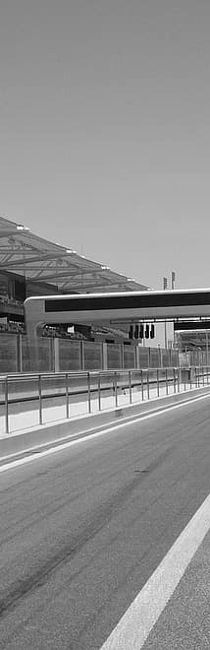

Introduction
This project aims to create a graph database representing the world of Formula 1.
Formula 1 (a.k.a. F1 or Formula One) is the highest category of single-seat auto racing sanctioned by the Fédération Internationale de l'Automobile (FIA) and owned by the Formula One Group.
The datasets used to create this database contain information regarding races, drivers, driver ratings, constructors, qualifying, circuits, lap times, pit stops, and championships from 1950 until the latest 2023 season.
The project also consists on some SPARQL queries to show how the database works.

Slide 3



Datasets
Formula 1 data:
https://ergast.com/mrd/ or
https://www.kaggle.com/datasets/rohanrao/formula-1-world-championship-1950-2020
The dataset consists of all information on the Formula 1 races, drivers, constructors, qualifying, circuits, lap times, pit stops, championships from 1950 till the latest 2023 season.
Ratings data:
2023: https://ratings-api.ea.com/v2/entities/f1-23-drivers-ratings
Older: https://github.com/toUpperCase78/formula1-datasets
Driver Ratings from EA & Codemasters F1 2021 / F1 22 / F1 23 Official Video Game
Country to Nationality csv:
https://github.com/Imagin-io/country-nationality-list/tree/master
Csv file that maps nationalities to countries.

Slide 4

Development process
Graph schema
Ontology
Serialization
Queries
Graph model designed to fit the F1 data
Developed with arrows.app
Ontology according to the Graph model
Developed with Protégé
Serialization process to produce turtle files
Developed with Jupyter Notebook
Queries writing to test the database
Developed with SPARQL

Slide 5
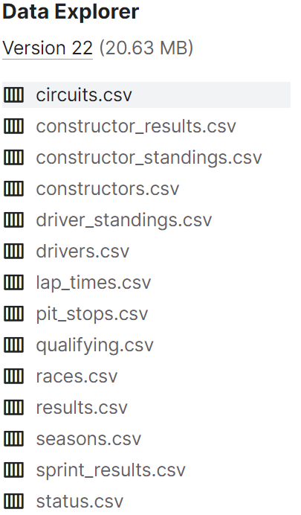
CSV files list
Dataset
circuits.csv | Circuits where F1 races are held
constructor_results.csv | Race results of the constructors’ championship
constructor_standings.csv | Final standings of the constructors’ championship
constructors.csv | Constructor teams in F1
driver_standings.csv | Final standings of the driver's championship
drivers.csv | Drivers in F1
lap_times.csv | Lap times in F1
nationalities.csv | Map nationalities to countries
pit_stops.csv | Pit stops in F1
qualifying.csv | Qualifying in F1
races.csv | Races in F1
ratings.csv | Ratings of F1 drivers
results.csv | Results of F1 races for each driver
seasons.csv | Seasons of F1
sprint_results.csv | Results of F1 sprint races for each driver
status.csv | Various status related to drivers’ results

Slide 6
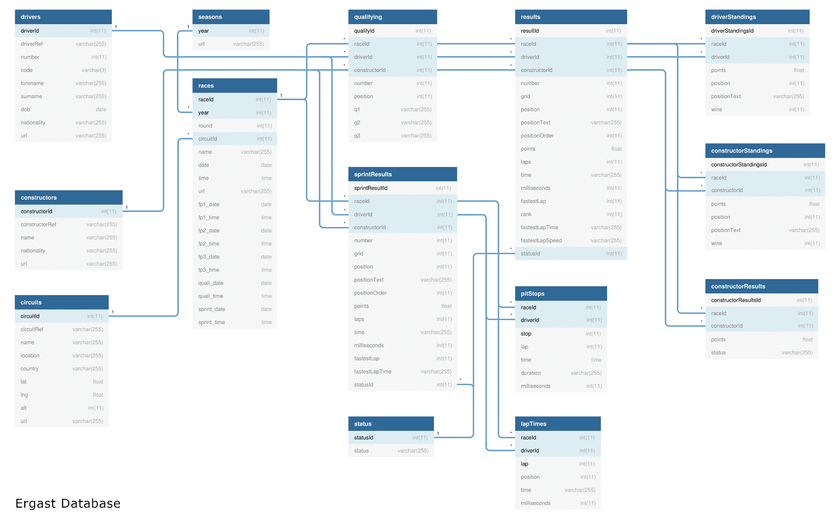
E-R Schema

Slide 7
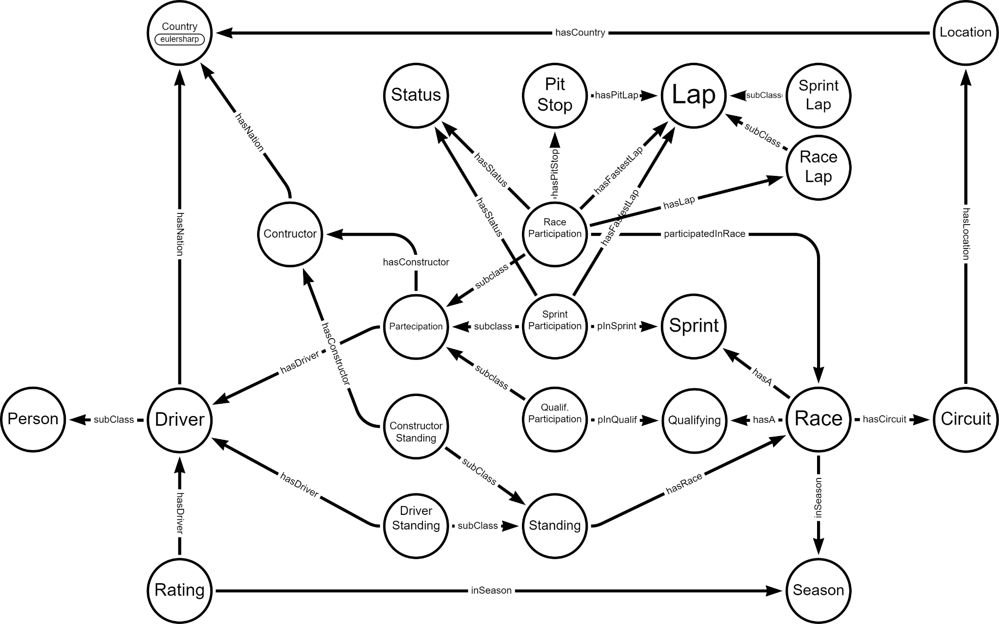
Graph Schema

Slide 8
Ontology

Slide 9
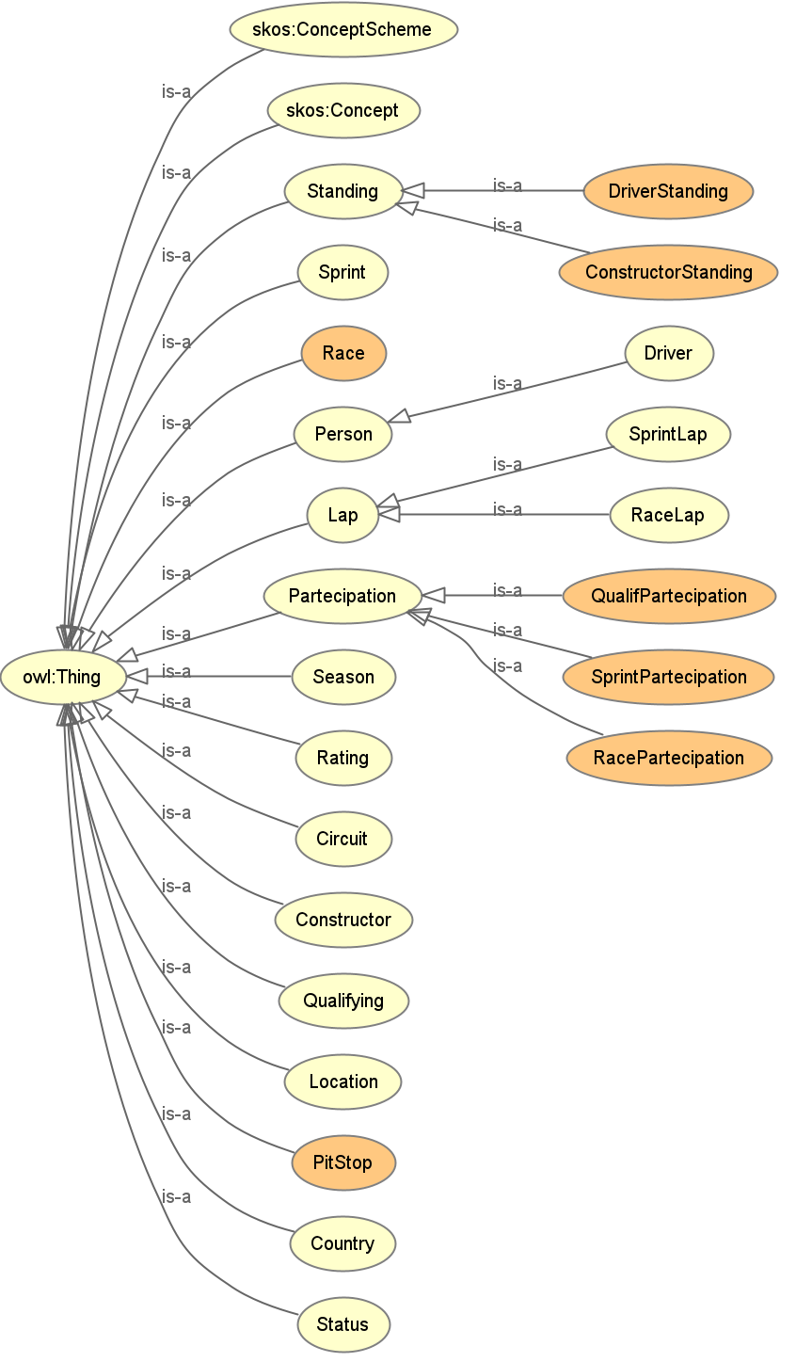
Class hierarchy
Ontology
Standing | Represents championship standings
DriverStanding | ...related to drivers
ConstructorStanding | ...related to constructors
Sprint | Represents a sprint race related to a specific race
Race | Represents a specific F1 race
Person | Represents a person in general
Driver | Represents a F1 driver
Lap | Represents a single lap in a generic race
SprintLap | Represents a single lap in a sprint
RaceLap | Represents a single lap in a race
Participation | Represents the participation of a driver and his related constructor team
QualifParticipation | ...to a qualifying
SprintParticipation | ...to a sprint
RaceParticipation | …to a race
Season | Represents a F1 season
Rating | Represents a rating tab for a driver
Circuit | Represents the circuits on which F1 races are done
Constructor | Represents F1 teams
Qualifying | Represents a qualifying related to a particular race
Location | Represents the location/city of a circuit
PitStop | Represents a single pitstop in a F1 race
Country | Represents world countries
Status | Represents a status of a driver or a car in a race/sprint

Slide 10
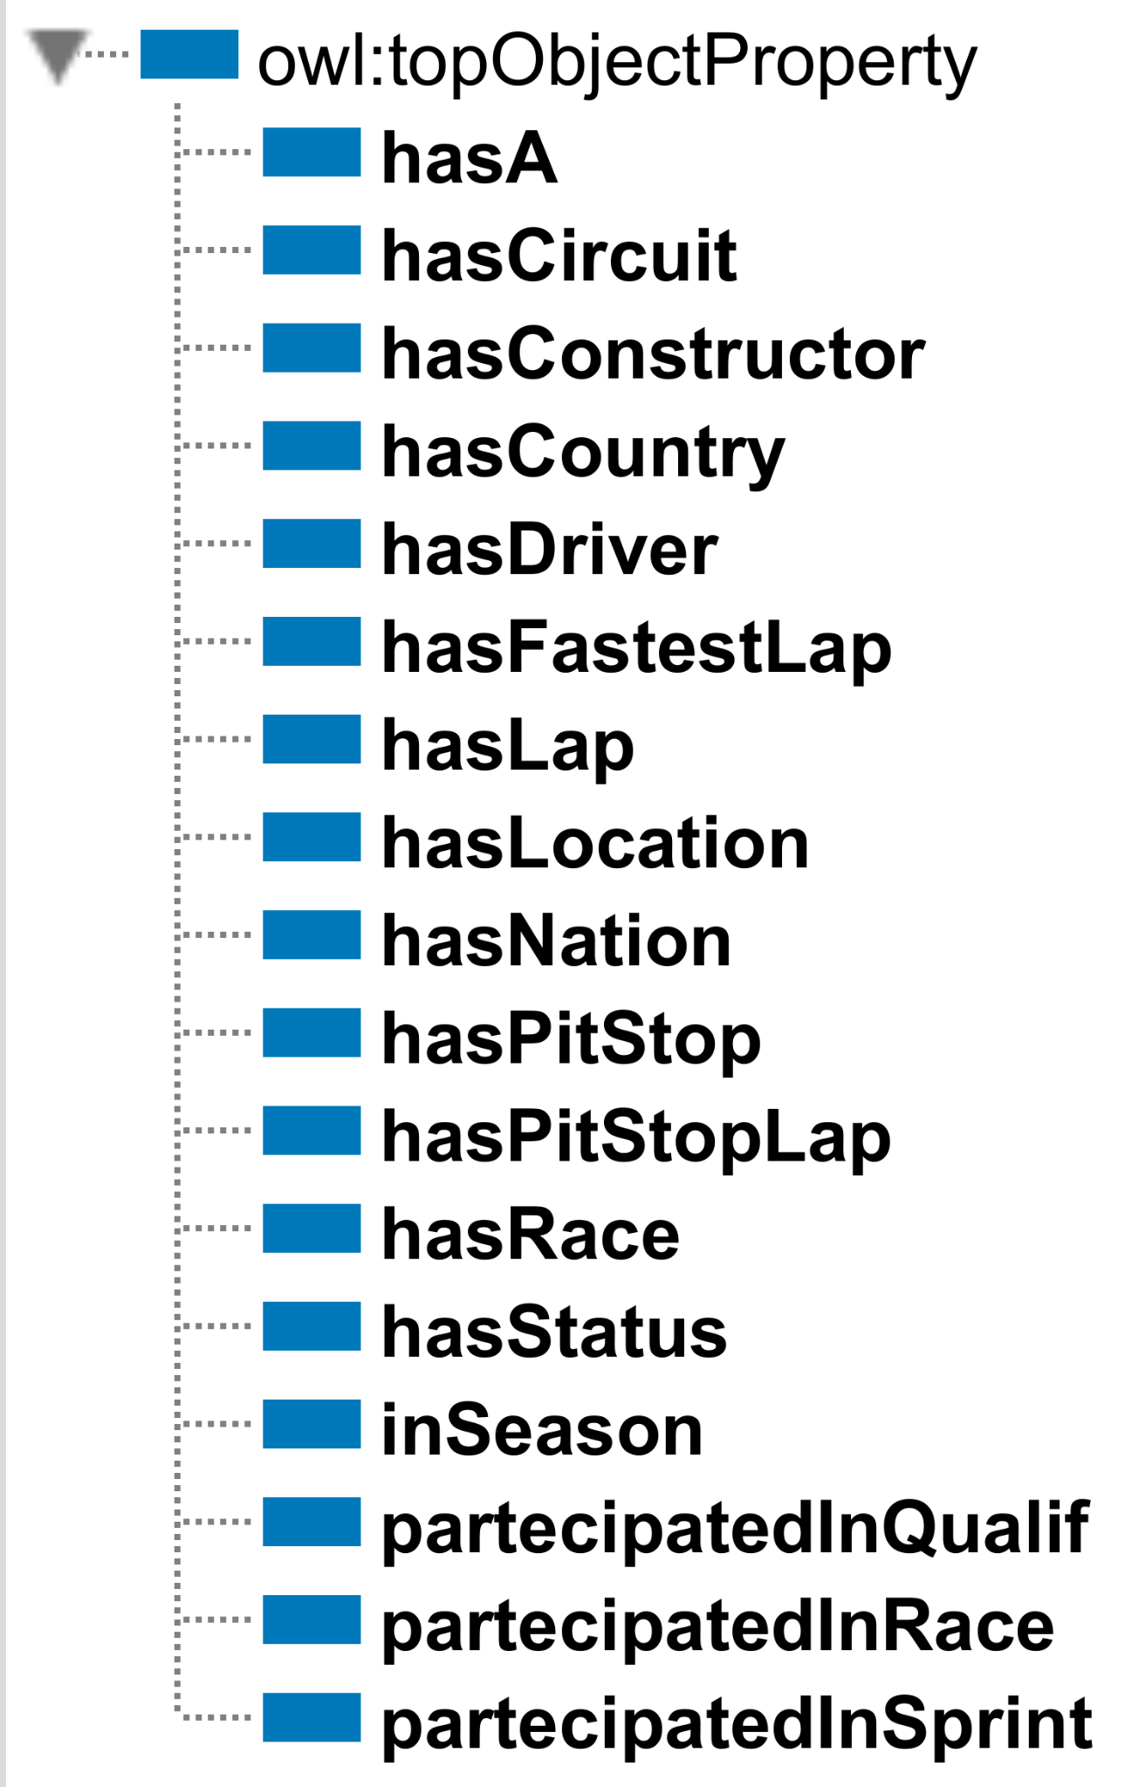
Object properties
Ontology
hasA (Race ↦ Qualifying or Sprint)
hasCircuit (Race ↦ Circuit) F
hasConstructor (ConstructorStanding or Participation ↦ Constructor) F
hasCountry (Location ↦ Country) F
hasDriver (DriverStanding or Participation or Rating ↦ Driver) F
hasFastestLap (RaceParticipation or SprintParticipation ↦ Lap) F
hasLap (RaceParticipation ↦ Lap)
hasLocation (Circuit ↦ Location) F
hasNation (Constructor or Driver ↦ Country)
hasPitStop (RaceParticipation ↦ PitStop)
hasPitStopLap (PitStop ↦ Lap)F
hasRace (Standing ↦ Race) F
hasStatus (RaceParticipation or SprintParticipation ↦ Status) F
inSeason (Race or Rating ↦ Season) F
participatedInQualif (QualifParticipation ↦ Qualifying) F
participatedInRace (RaceParticipation ↦ Race) F
participatedInSprint (SprintParticipation ↦ Sprint) F

Slide 11
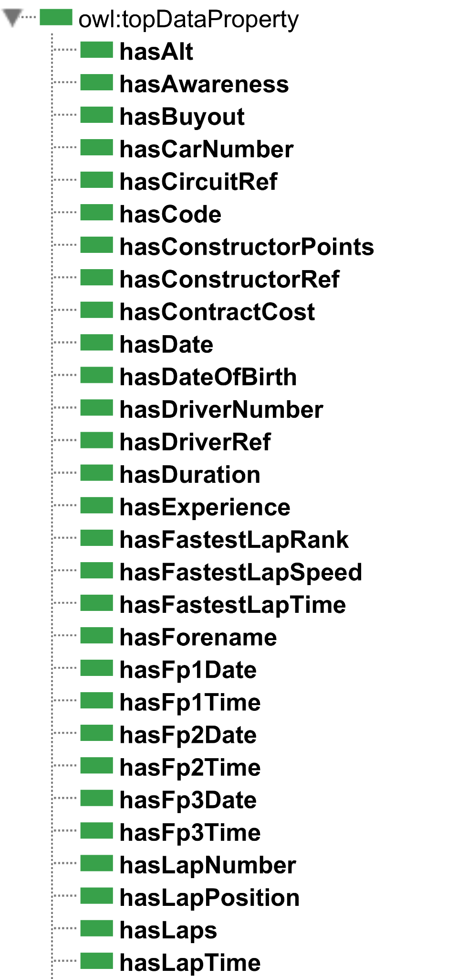
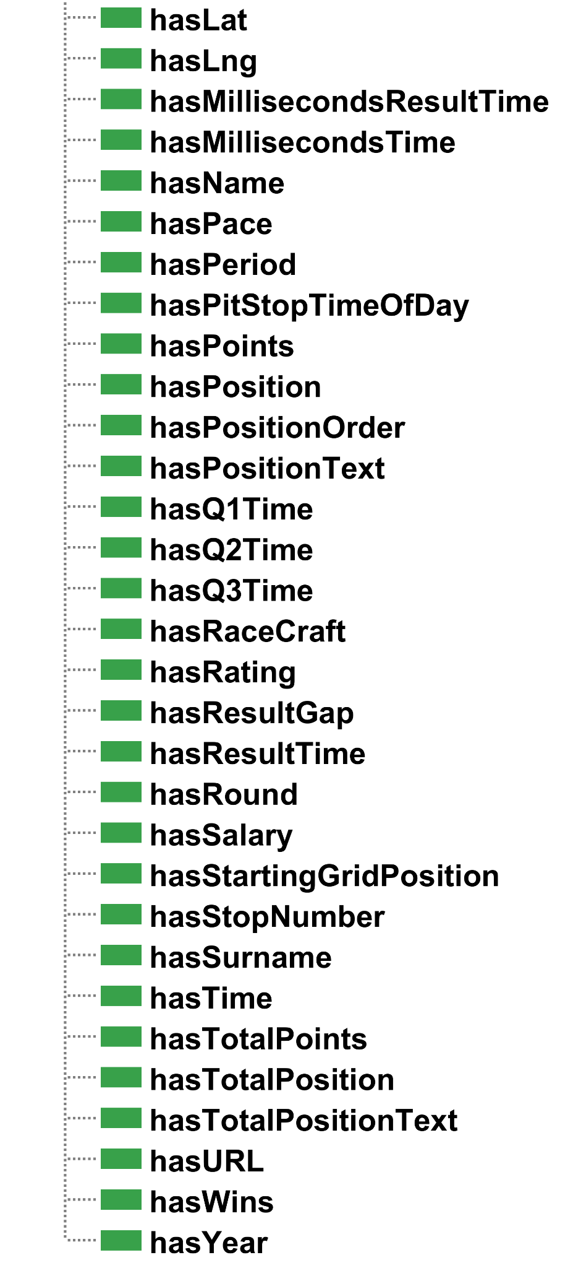
Data properties
Ontology

Slide 12
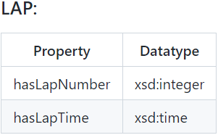
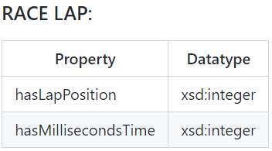
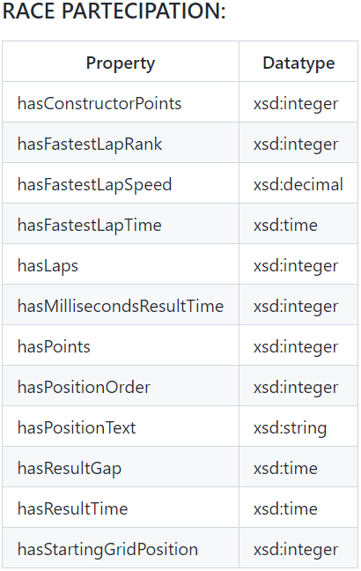
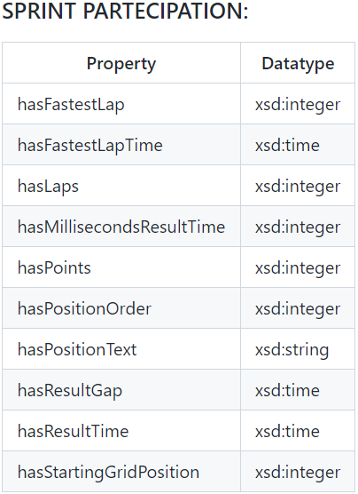
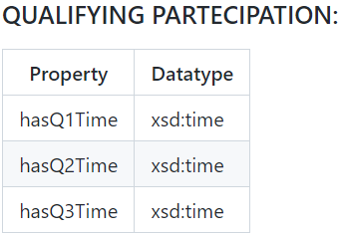
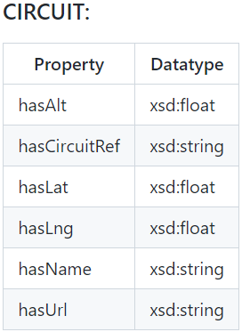
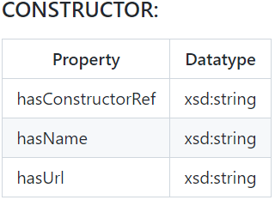
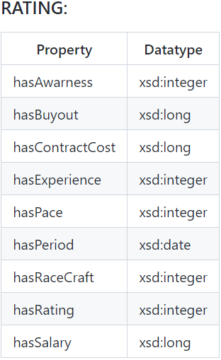
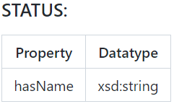
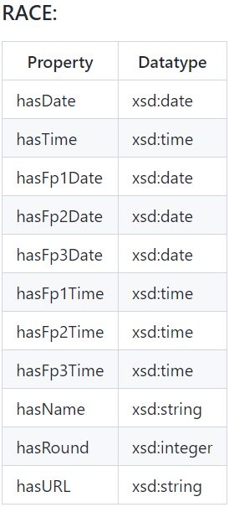
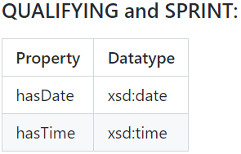
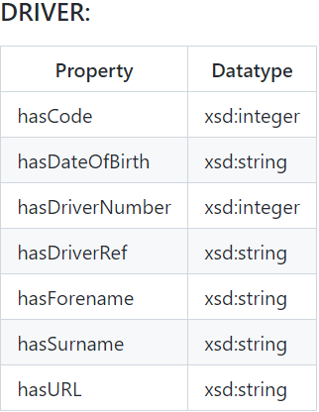
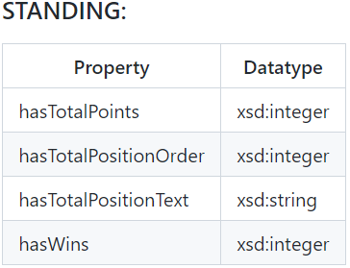
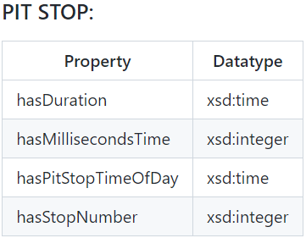
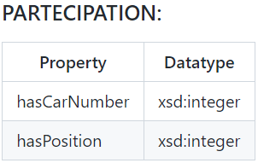
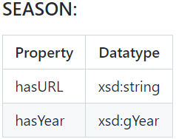
Data properties
Ontology

Slide 13
Serialization

Slide 14
Introduction
Serialization
Turtle files produced by the serialization process:
Turtle files | Csv files from which we extracted the data for the turtle files
circuits.ttl | circuits.csv, countries.csv
constructors.ttl | constructors.csv, nationalities.csv
drivers.ttl | drivers.csv, nationalities.csv
laps1.ttl and laps2.ttl | lap_times.csv, results.csv, constructor_results.csv
qualifying.ttl | qualifying.csv, races.csv
race.ttl | races.csv
race_participation.ttl | results.csv, constructor_results.csv, lap_times.csv
ratings.ttl | ratings.csv, drivers.csv
sprint.ttl | sprint_results.csv, races.csv
standings.ttl | driver_standings.csv, constructor_standings.csv
status_season.ttl | status.csv, seasons.csv
stops.ttl | pit_stops.csv, results.csv, constructor_results.csv, lap_times.csv

Slide 15



Matching columns
Serialization
Join
We joined results.csv and constructor_results.csv in a single Pandas data frame. Then, all the results concerning the constructor team were matched with the driver results before managing the data frame.
Search
For each current row evaluated, we searched for a matching row in the second table in order to match some constraints, such as some keys.
results
constructor_result
left join
joined df
race_part
laps
search

Slide 16
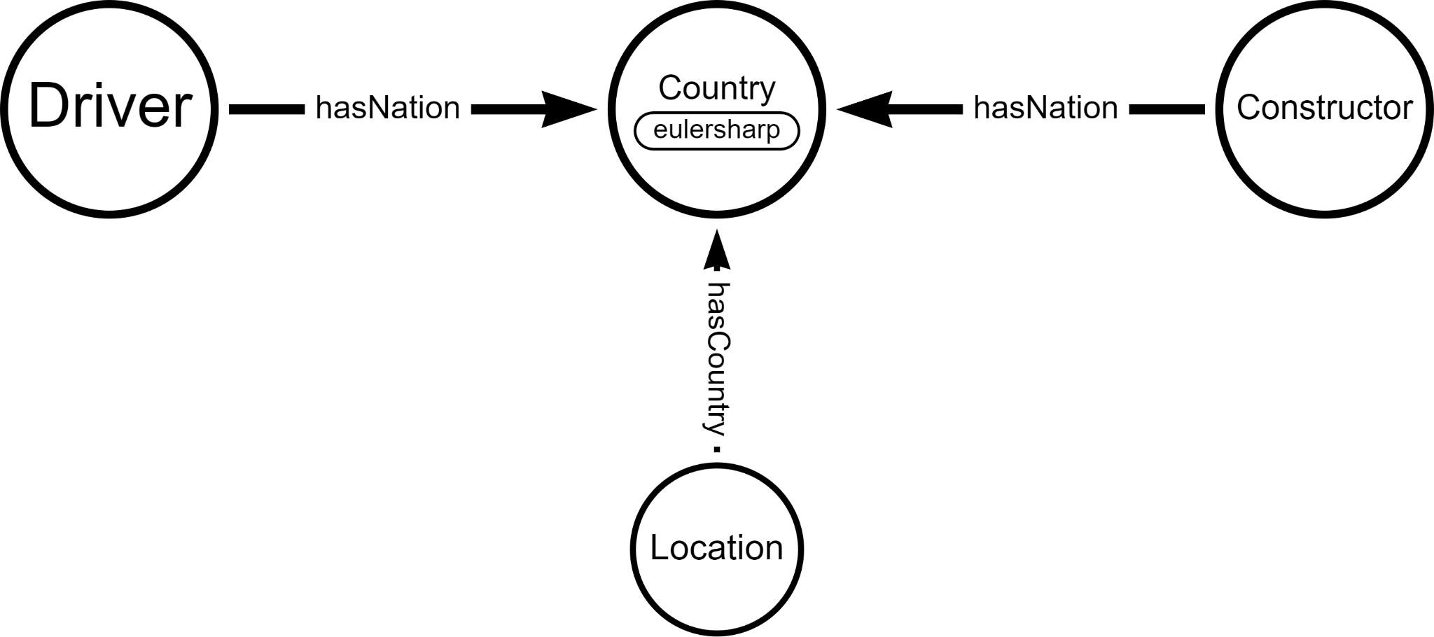

Nationality to country mapping
Serialization
We used this approach in drivers.ttl and constructors.ttl to maintain a single class country taken by an external source.
In this way, we avoided creating an additional nationality class and it was not necessary to link each individual in the nationality class to the country class via an object property.
The mapping was done directly in the serialization step.
num_code | alpha_2_code | alpha_3_code | en_short_name | nationality
4 | AF | AFG | Afghanistan | Afghan
248 | AX | ALA | Åland Islands | Åland Island
8 | AL | ALB | Albania | Albanian
12 | DZ | DZA | Algeria | Algerian
16 | AS | ASM | American Samoa | American Samoan
20 | AD | AND | Andorra | Andorran
24 | AO | AGO | Angola | Angolan
660 | AI | AIA | Anguilla | Anguillan
10 | AQ | ATA | Antarctica | Antarctic
28 | AG | ATG | Antigua and Barbuda | Antiguan or Barbudan
32 | AR | ARG | Argentina | Argentine

Slide 17
Time format
Serialization
We used 3 functions to manage time:
time_formatter
Function that transforms a time value to the standard %H:%M:%S.%f format, adds the zeros and the missing colon to the beginning and end of the string.
gap_formatter
Function that transforms a gap time value to the standard %H:%M:%S.%f format, adds the zeros and the missing colon to the beginning and end of the string.
time_converter
Function that calculates a driver's actual arrival time using the winner's arrival time and the time distance from it.
17:02.3
t_f
00:17:02.300
1:47:02.345
t_f
01:47:02.345
+7:02.345
g_f
00:07:02.345
+145.31
g_f
00:02:25.310
Driver gap time:
+122.345
Winner arrival time:
1:00:00.000
Driver arrival time:
01:02:02.345

Slide 18
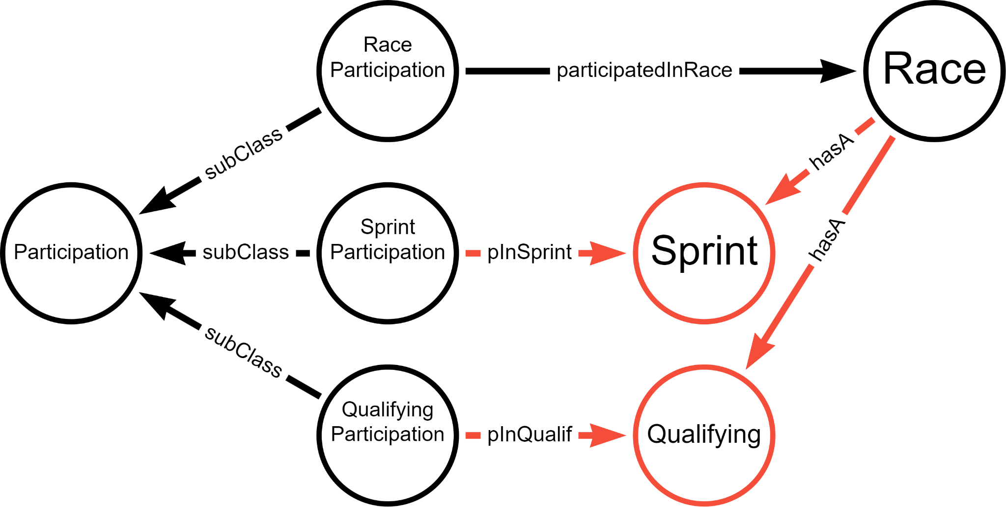
Qualifying and Sprint classes
Serialization
In the source dataset, we have two csv files concerning the races:
the one for the generic race (races.csv) and
the one for each driver's participation in the race (results.csv).
For qualifying and sprints this does not happen and we only have files representing the participations (qualifying.csv, sprint_results.csv).
To make the database more consistent, we decided to add two classes, Sprint and Qualifying, to represent the generic sprints and qualifications, not related to the driver.
quali_date^^xsd:date
quali_time^^xsd:time
… | quali_date | quali_time | … | …
 | 2020/01/05 | 17:00:00
 | 2021/06/20 | 18:00:00
 | 2023/07/01 | 19:00:00
Qualifying
races.csv

Slide 19
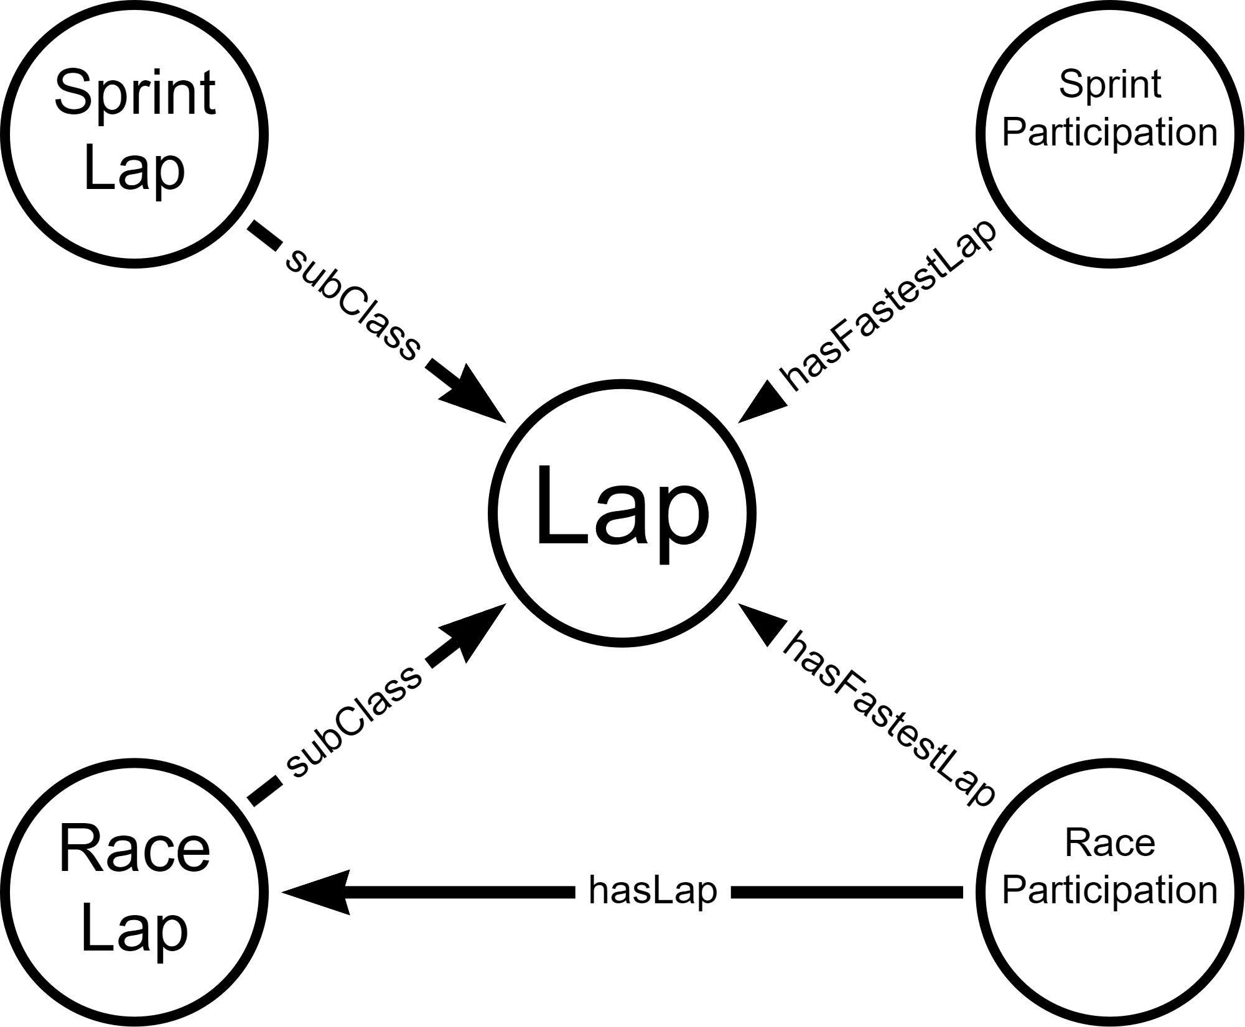
Race and sprint laps
Serialization
In the source dataset, we have the lap_times.csv file that contains all the laps of each driver in each race, with their positions and times.
Consequently, we decided to create a subclass of Lap, called SprintLap, to include the fastest laps related to sprints, with related time.
We also chose to keep this information in SprintParticipation so that it would be faster to extract it in SPARQL.

Slide 20
Queries

Slide 21
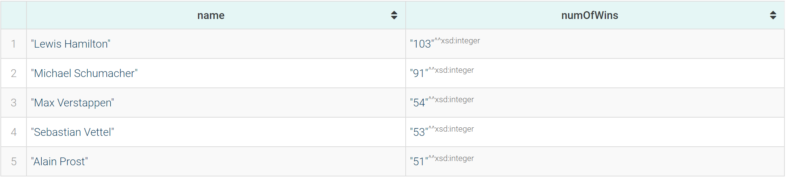
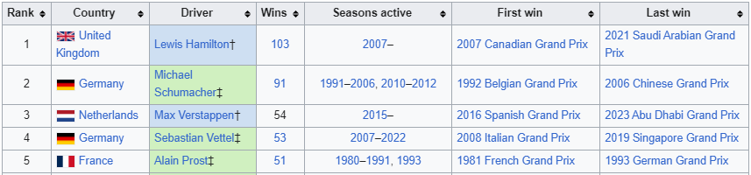
The 5 most winning drivers in F1 history, ordered by number of grand prix wins
Query 8.1
PREFIX : <https://www.dei.unipd.it/db2/groupProject/FASTianF1#>
PREFIX xsd: <http://www.w3.org/2001/XMLSchema#>
SELECT ?name (COUNT(?name) as ?numOfWins) WHERE {
?race :hasCircuit ?circuit;
a :Race.
?racePart :partecipatedInRace ?race;
:hasPositionOrder "1"^^xsd:integer;
:hasDriver ?driver.
?driver a :Driver;
:hasForename ?fname;
:hasSurname ?sname.
BIND(CONCAT(?fname, " ", ?sname) AS ?name).
} GROUP BY ?name
ORDER BY DESC (?numOfWins)
LIMIT 5
SPARQL RESULT
WIKIPEDIA

Slide 22
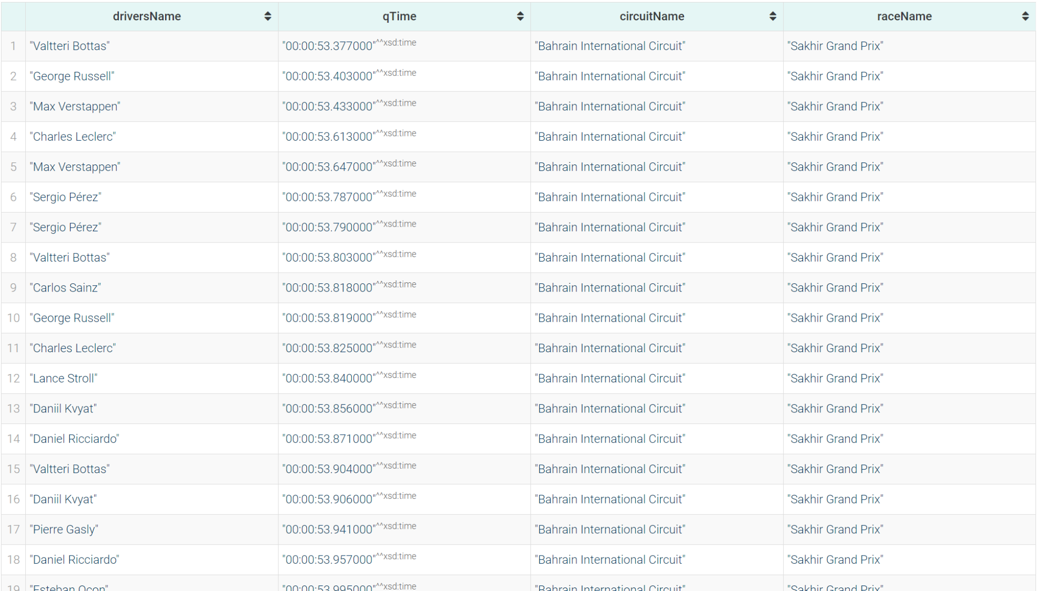
Data about fastest qualifying laps in F1 history (both q1, q2 and q3)
Query 11.3
PREFIX : <https://www.dei.unipd.it/db2/groupProject/FASTianF1#>
PREFIX xsd: <http://www.w3.org/2001/XMLSchema#>
SELECT ?driversName ?qTime ?circuitName ?raceName WHERE {
{
?qualPart :hasQ3Time ?qTime.
}
UNION
{
?qualPart :hasQ2Time ?qTime.
}
UNION
{
?qualPart :hasQ1Time ?qTime.
}
?qualPart :hasDriver ?driver;
:partecipatedInQualif ?quali;
a :QualifPartecipation.
?quali a :Qualifying.
?race a :Race;
:hasA ?quali;
:hasName ?raceName;
:hasCircuit ?circ.
?circ a :Circuit;
:hasName ?circuitName.
?driver a :Driver;
:hasForename ?fname;
:hasSurname ?sname.
BIND(CONCAT(?fname, " ", ?sname) AS ?driversName).
FILTER(?qTime != "00:00:00"^^xsd:time)
}
ORDER BY (?qTime)
LIMIT 100
SPARQL RESULT

Slide 23
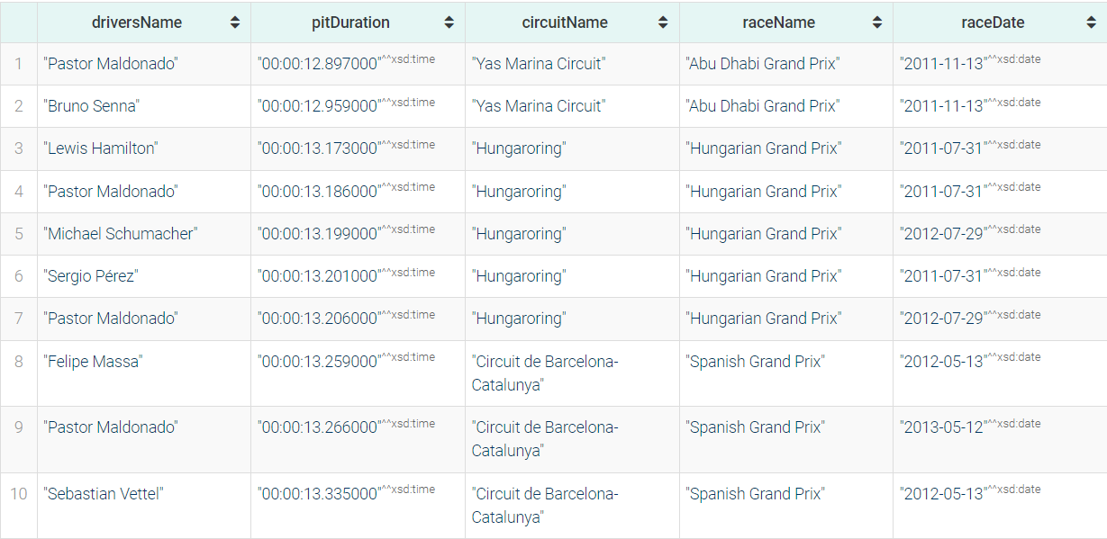
Data about 10 fastest pit stops in F1 history
Query 12
PREFIX : <https://www.dei.unipd.it/db2/groupProject/FASTianF1#>
PREFIX xsd: <http://www.w3.org/2001/XMLSchema#>
SELECT ?driversName ?pitDuration ?circuitName ?raceName ?raceDate WHERE {
?racePart :hasPitStop ?pit;
:hasDriver ?driver;
:partecipatedInRace ?race;
a :RacePartecipation.
?race a :Race;
:hasName ?raceName;
:hasDate ?raceDate;
:hasCircuit ?circ.
?circ a :Circuit;
:hasName ?circuitName.
?pit a :PitStop;
:hasDuration ?pitDuration.
?driver a :Driver;
:hasForename ?fname;
:hasSurname ?sname.
BIND(CONCAT(?fname, " ", ?sname) AS ?driversName).
}
ORDER BY (?pitDuration)
LIMIT 10
SPARQL RESULT

Slide 24
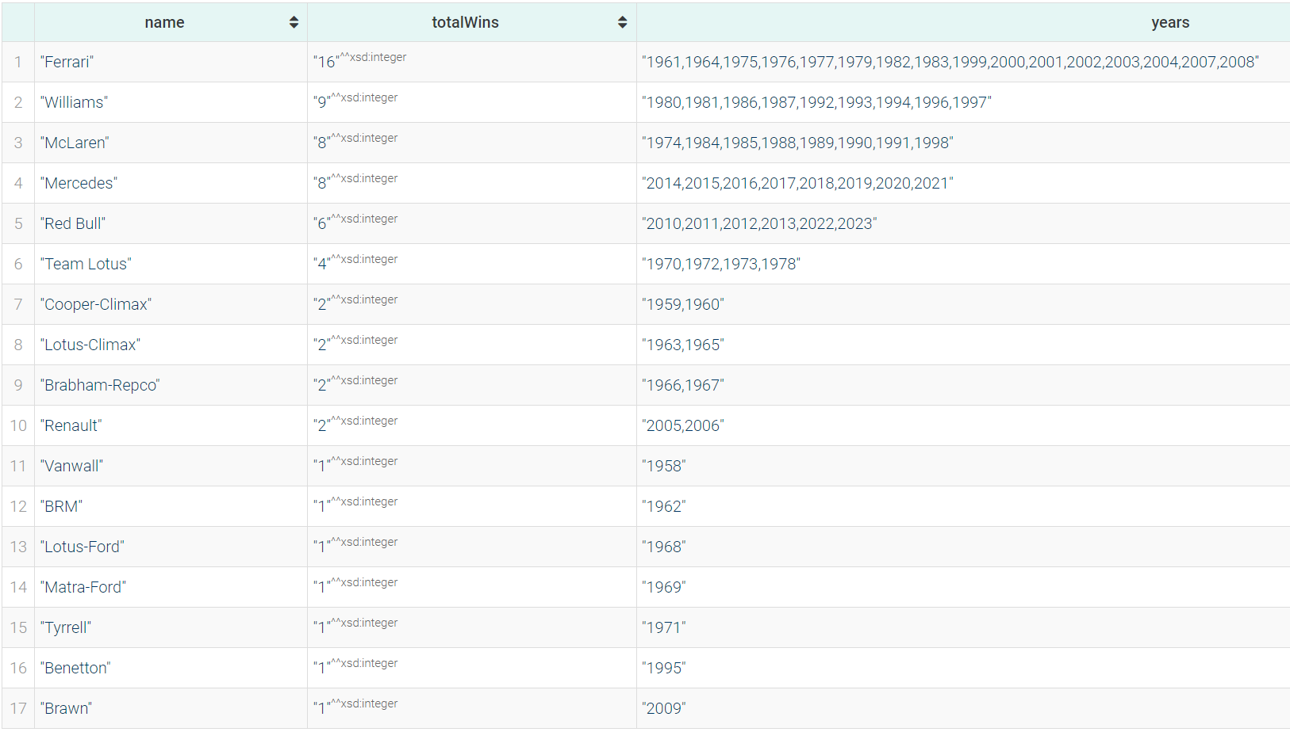
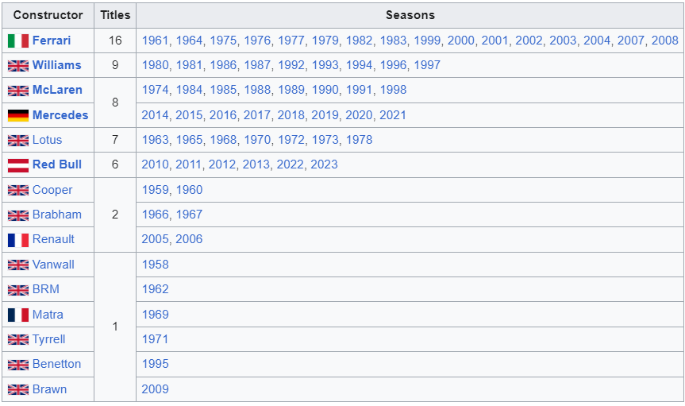
Constructors with most wins in the constructors' championship
Query 14
SPARQL RESULT
PREFIX : <https://www.dei.unipd.it/db2/groupProject/FASTianF1#>
SELECT ?name (COUNT(?name) AS ?totalWins) (GROUP_CONCAT(DISTINCT ?outerYear ; separator=",") AS ?years) WHERE{
{
SELECT ?name ?race (AVG(?pos) AS ?finalPosition) ?outerYear WHERE{
?stand :hasRace ?race ;
:hasConstructor ?cons ;
:hasTotalPosition ?pos .
?race :hasRound ?outerRound ;
:inSeason ?outerSeason .
?outerSeason :hasYear ?outerYear .
?cons :hasName ?name .
FILTER(?outerRound = ?maxRound && ?outerYear = ?year && ?pos = 1)
{
SELECT ?year (MAX(?round) AS ?maxRound) WHERE {
?race :inSeason ?season ;
:hasRound ?round .
?season :hasYear ?year .
}
GROUP BY ?year
}
}
GROUP BY ?name ?race ?outerYear
ORDER BY (?outerYear)
}
}
GROUP BY ?name
ORDER BY DESC (?totalWins)
WIKIPEDIA

Slide 25

Are drivers who won the championship after 2000 older than those who won it before 2000, on average?
Query 16
PREFIX : <https://www.dei.unipd.it/db2/groupProject/FASTianF1#>
ASK WHERE{
{
SELECT (AVG(?age) as ?avgOldAge) WHERE{
?stand :hasRace ?race ;
:hasDriver ?driv ;
:hasTotalPosition ?pos .
?driv :hasDateOfBirth ?dob .
?race :hasDate ?raceDate ;
:inSeason ?outerSeason ;
:hasRound ?outerRound .
?outerSeason :hasYear ?outerYear .
BIND((YEAR(?raceDate) - YEAR(?dob)) AS ?age)
FILTER(?outerRound = ?maxRound && ?outerYear = ?year && ?pos = 1)
{
SELECT ?year (MAX(?round) AS ?maxRound) WHERE {
?race :inSeason ?season ;
:hasRound ?round .
?season :hasYear ?year .
FILTER(?year < 2000)
}
GROUP BY ?year
}
}
}
{
SELECT (AVG(?age) as ?avgRecentAge) WHERE{
?stand :hasRace ?race ;
:hasDriver ?driv ;
:hasTotalPosition ?pos .
?driv :hasDateOfBirth ?dob .
?race :hasDate ?raceDate ;
:inSeason ?outerSeason ;
:hasRound ?outerRound .
?outerSeason :hasYear ?outerYear .
BIND((YEAR(?raceDate) - YEAR(?dob)) AS ?age)
FILTER(?outerRound = ?maxRound && ?outerYear = ?year && ?pos = 1)
{
SELECT ?year (MAX(?round) AS ?maxRound) WHERE {
?race :inSeason ?season ;
:hasRound ?round .
?season :hasYear ?year .
FILTER(?year >= 2000)
}
GROUP BY ?year
}
}
}
FILTER(?avgRecentAge > ?avgOldAge)
}
SPARQL RESULT
Before 2000 avg age:
33.0
After 2000 avg age:
28.8

Slide 26
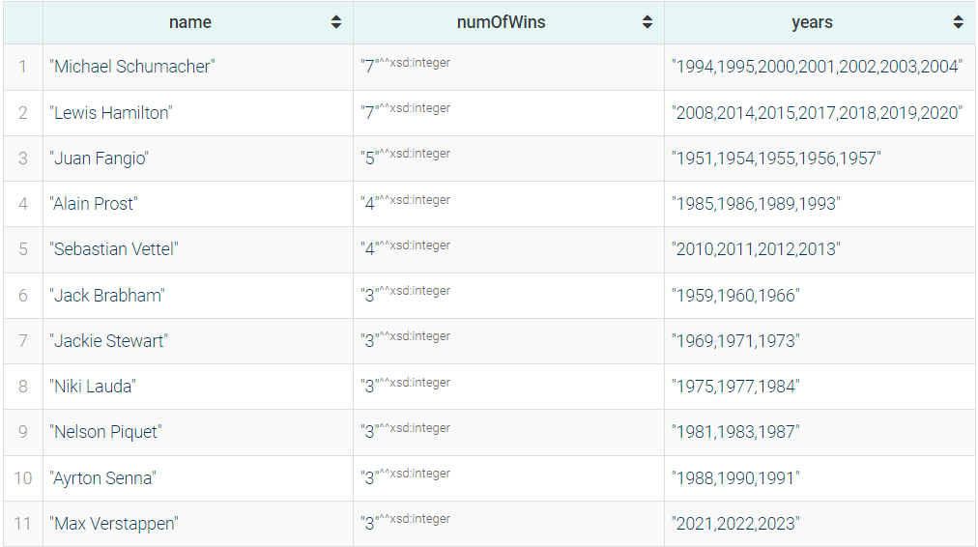
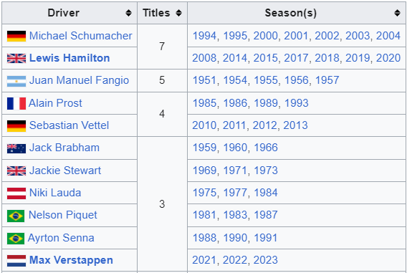
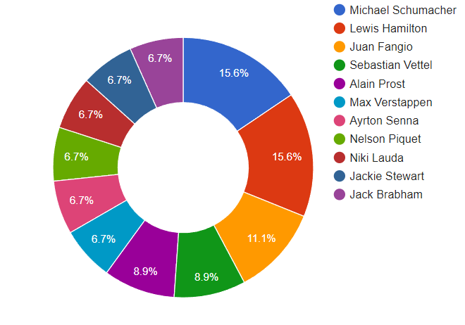
Championship winning drivers who won more than 2 championships, ordered by number of championships won
Query 19
SPARQL RESULT
PREFIX : <https://www.dei.unipd.it/db2/groupProject/FASTianF1#>
SELECT ?name (COUNT(?name) AS ?numOfWins)(GROUP_CONCAT(DISTINCT ?outerYear ; separator=",") AS ?years) WHERE{
?stand :hasRace ?race ;
:hasDriver ?driv ;
:hasTotalPosition ?pos .
?driv a :Driver;
:hasForename ?fname;
:hasSurname ?sname.
BIND(CONCAT(?fname, " ", ?sname) AS ?name).
?race :hasDate ?raceDate ;
:inSeason ?outerSeason ;
:hasRound ?outerRound .
?outerSeason :hasYear ?outerYear .
FILTER(?outerRound = ?maxRound && ?outerYear = ?year && ?pos = 1)
{
SELECT ?year (MAX(?round) AS ?maxRound) WHERE {
?race :inSeason ?season ;
:hasRound ?round .
?season :hasYear ?year .
}
GROUP BY ?year
ORDER BY ?year
}
}
GROUP BY ?name
HAVING (?numOfWins > 2)
ORDER BY DESC (?numOfWins)
WIKIPEDIA

Slide 27
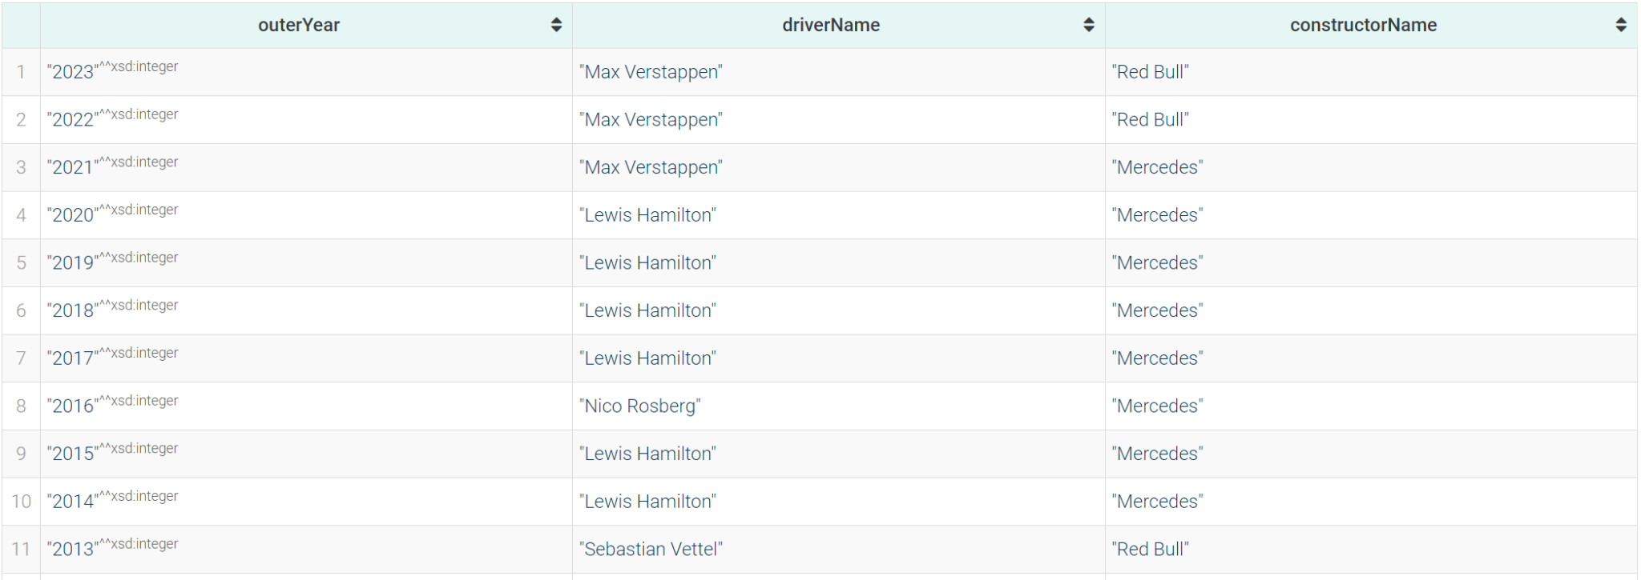
Winners of drivers’ championship and constructors’ championship for each season.
Query 22
PREFIX : <https://www.dei.unipd.it/db2/groupProject/FASTianF1#>
SELECT ?outerYear ?driverName ?constructorName WHERE{
?driverStand :hasTotalPosition ?pos ;
:hasRace ?race ;
:hasDriver ?driver .
?constStand :hasTotalPosition ?pos ;
:hasRace ?race ;
:hasConstructor ?const .
?race :hasRound ?outerRound ;
:inSeason ?season .
?season :hasYear ?outerYear .
?driver :hasForename ?fname ;
:hasSurname ?sname .
?const :hasName ?constructorName .
BIND(CONCAT(?fname, " ", ?sname) AS ?driverName).
FILTER(?outerRound = ?maxRound && ?outerYear = ?year && ?pos = 1)
{
SELECT ?year (MAX(?round) AS ?maxRound) WHERE {
?race :inSeason ?season ;
:hasRound ?round .
?season :hasYear ?year .
}
GROUP BY ?year
}
}
ORDER BY DESC (?outerYear)
SPARQL RESULT

Slide 28
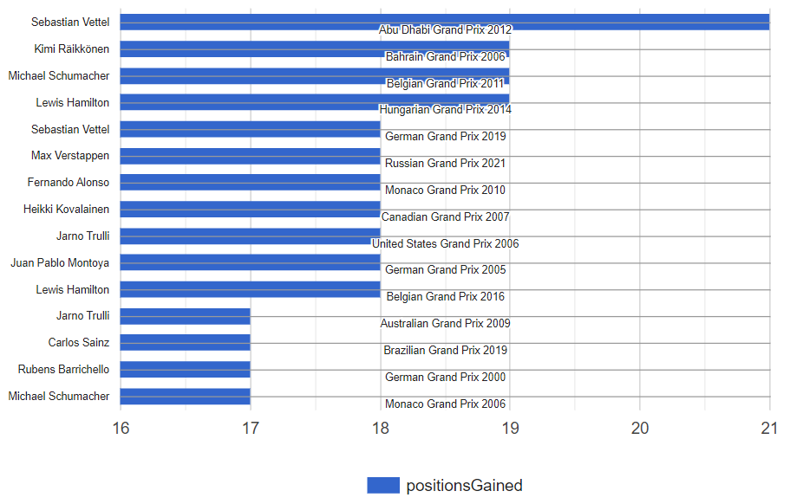
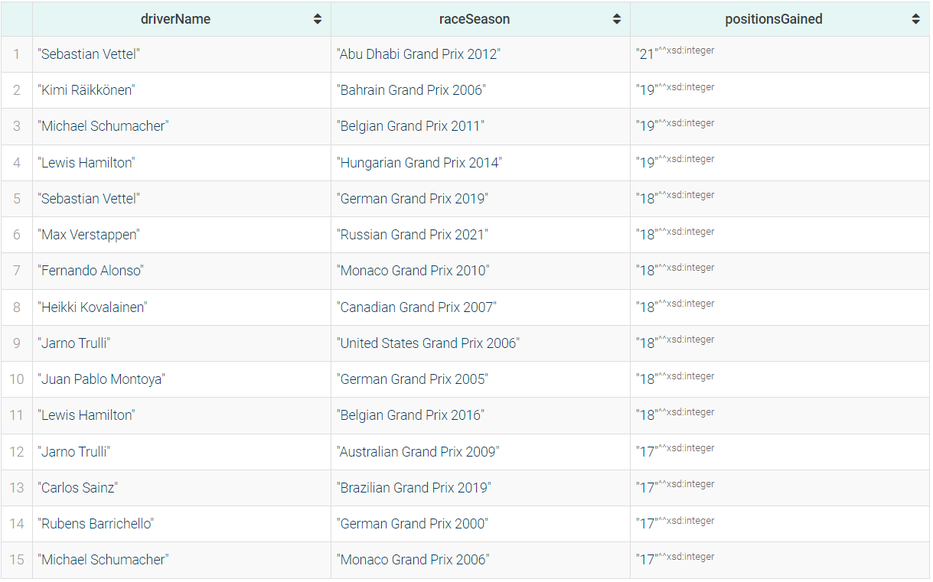
Drivers who gained the most positions during a race after 2000
Query 23
BAR CHART
PREFIX : <https://www.dei.unipd.it/db2/groupProject/FASTianF1#>
SELECT ?driverName ?raceSeason ?positionsGained WHERE{
?part :hasStartingGridPosition ?grid ;
:partecipatedInRace ?race ;
:hasDriver ?driver ;
:hasPosition ?pos .
?driver :hasForename ?fname ;
:hasSurname ?sname .
?race :inSeason ?season ;
:hasName ?raceName .
?season :hasYear ?year .
BIND(CONCAT(?fname, " ", ?sname) AS ?driverName)
BIND((?grid - ?pos) AS ?positionsGained)
FILTER(?year >= 2000)
BIND(CONCAT(?raceName, " ", STR(?year)) AS ?raceSeason)
}
ORDER BY DESC (?positionsGained)
LIMIT 15
SPARQL RESULT

Slide 29
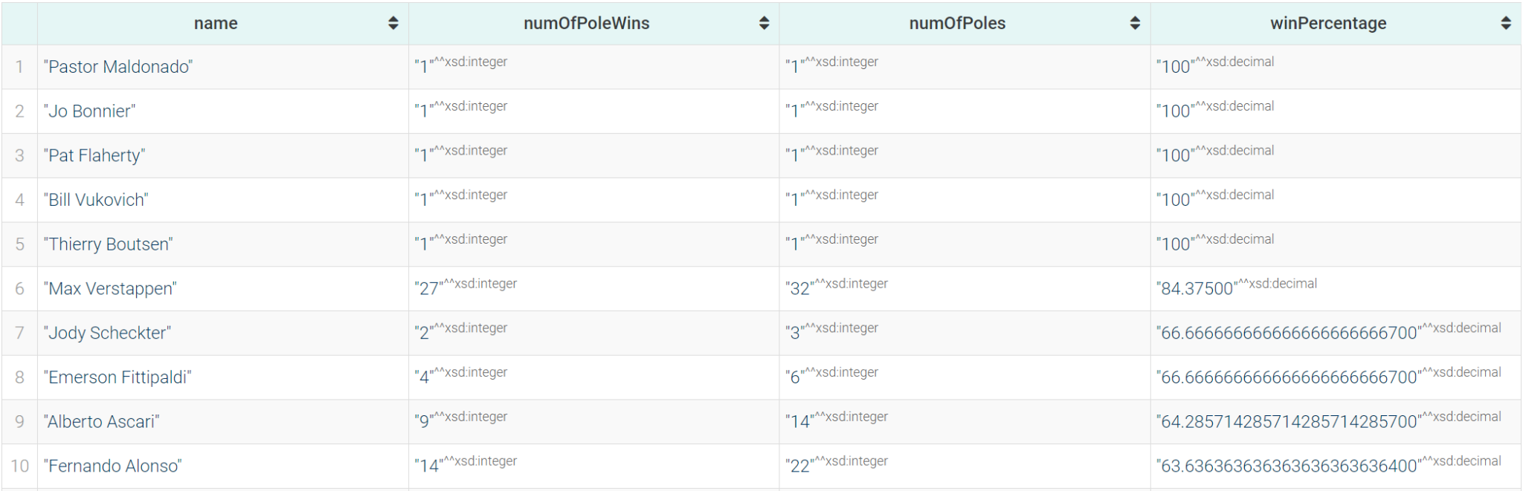
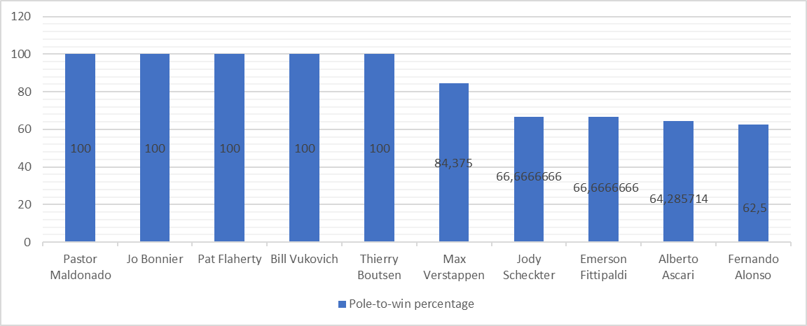
Drivers ordered by pole-to-win percentage (percentage of races won starting from the first position in grid)
Query 24
SPARQL RESULT
PREFIX : <https://www.dei.unipd.it/db2/groupProject/FASTianF1#>
SELECT ?name ?numOfPoleWins ?numOfPoles ?winPercentage WHERE{
{
SELECT ?name (COUNT(?name) AS ?numOfPoleWins) WHERE{
?racePart :partecipatedInRace ?race ;
:hasDriver ?driv ;
:hasStartingGridPosition ?startPos ;
:hasPosition ?pos .
?driv a :Driver;
:hasForename ?fname;
:hasSurname ?sname.
BIND(CONCAT(?fname, " ", ?sname) AS ?name).
FILTER(?startPos = 1 && ?pos = 1)
}
GROUP BY ?name
}
{
SELECT ?name (COUNT(?name) AS ?numOfPoles) WHERE{
?racePart :partecipatedInRace ?race ;
:hasDriver ?driv ;
:hasStartingGridPosition ?startPos .
?driv a :Driver;
:hasForename ?fname;
:hasSurname ?sname.
BIND(CONCAT(?fname, " ", ?sname) AS ?name).
FILTER(?startPos = 1)
}
GROUP BY ?name
}
BIND((?numOfPoleWins / ?numOfPoles) * 100 AS ?winPercentage)
}
ORDER BY DESC (?winPercentage)
BAR CHART

Slide 30
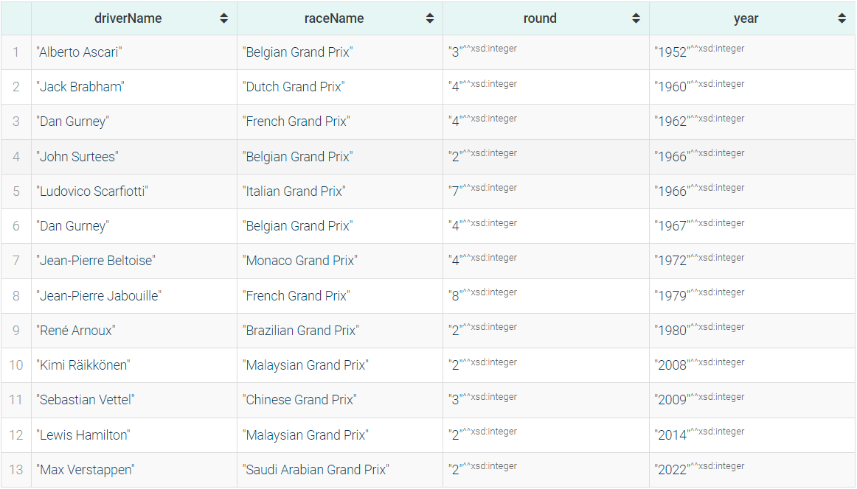
Drivers who finished first in a race and were placed in the last quarter in the standing at the previous race
Query 25
PREFIX : <https://www.dei.unipd.it/db2/groupProject/FASTianF1#>
SELECT ?driverName ?raceName ?round ?year WHERE{
?race :hasRound ?round ;
:inSeason ?season ;
:hasName ?raceName .
?part :partecipatedInRace ?race ;
:hasPosition ?pos ;
:hasDriver ?driver .
?driver :hasForename ?fname ;
:hasSurname ?lname .
?season :hasYear ?year .
BIND((?round-1) AS ?prevRound)
BIND(CONCAT(?fname," ",?lname) AS ?driverName)
FILTER(?pos = 1 && EXISTS{
?prevRace :hasRound ?prevRound ;
:inSeason ?season .
?stand :hasRace ?prevRace ;
:hasDriver ?driver ;
:hasTotalPosition ?totPos .
FILTER (?totPos >= ((?maxPos/4)*3) && ?prevRace = ?raceMax)
{
SELECT ?raceMax (MAX(?totPos) AS ?maxPos) WHERE {
?standing a :DriverStanding ;
:hasRace ?raceMax ;
:hasTotalPosition ?totPos .
}
GROUP BY ?raceMax
}
})
}
ORDER BY (?year)
SPARQL RESULT

Slide 31

Thank you!

